Slide 2

Notes:
Andrew
Do you remember the last job you had? How was your first day? Did you feel prepared enough for the rest of your work term?

Slide 3
“A lot of wasted time…”
“ughhhhhhh”
“Just wanted to get it over with…”
Notes:
Andrew
These are just some of the ways people described their onboarding experiences…

Slide 4
New Hires
Felt more time was spent than necessary on introductory or administrative topics.
Underprepared for actual technical work.
Experienced varied depending on the level of commitment from reporting managers.
HR / Managers
High Levels of time commitment.
Disconnect between HR Personnel and technical hires.
Long time-to-productivity.
Notes:
Andrew
In general, new hires…

Slide 5
Lower time-to-productivity
Lower training cost per hire
Better experience
Potential increase to company
Money / time / effort
Better public image for future hires.
Notes:
Natalie
A better onboarding experience doesn’t have to just mitigate the bad, it can also bring real gains…

Slide 6

Reduce time-to-productivity.
Ensure required resources are available and up-to-date.
Increase confidence, inclusiveness and comfort.
Notes:
Natalie
What do they do day to day…

Slide 7
Technically Orientated
Lessen Commitment
Productive Faster
Notes:
Al
What if there was a solution…

Slide 8
Better
Experience
Lower
Cost
Better Productivity
Notes:
Al
That can also bring a…

Slide 9
Immersive Technical Training
Self-Serve
VR
Onboarding
Analytics
Notes:
Al
Our solution would previde the newhires and current employees

Slide 10



Major VR Player
Provide visualizations to convey complex subjects.
Expensive.
Slow delivery.
Automating HR onboarding process.
HR / Administrative orientated.
Does not involve education or learning.
Reduction of onboarding paperwork.
Checklist focussed.
Dependent on reporting manager.
Notes:
Tianyi
Here are some current players in use…

Slide 11

Technical
User
Focussed
Lightweight
Notes:
Tianyi
We want to be here

Slide 12
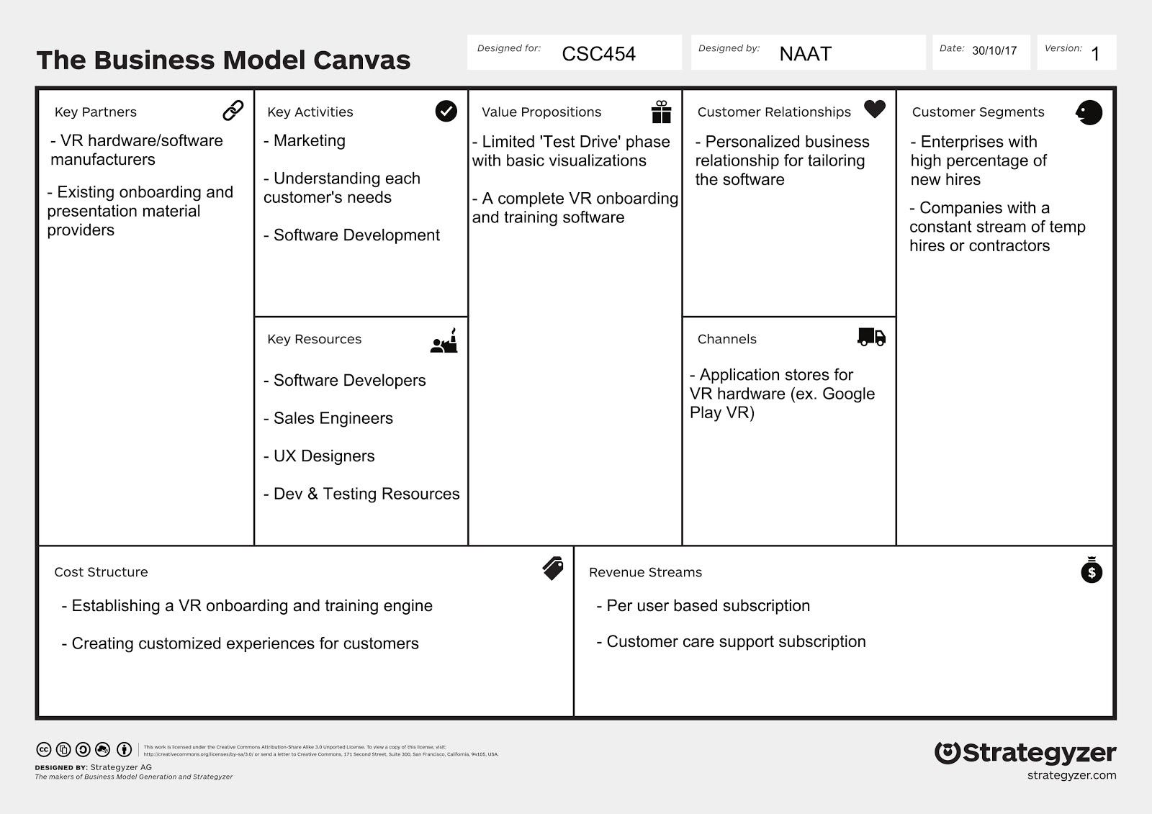
Notes:
Tianyi
We won’t go through each point but here are some highlights…

Slide 13




VR technology
3D modelling and animation
Informed technical experience
Notes:
Andrew
This project would involve…

Slide 14
Productive From Day One
Notes:
Andrew
Vision

